Slide 1

Real time circle detection

Slide 2

INTRODUCTION
OpenCV has an inbuilt function for detection of circular shapes, but has no function for shapes like triangle, rectangle etc.
In order to detect a colour ball of a particular colour we must follow the following steps:
1) Convert the image from camera from its colour space, let it be
RGB to HSV colour space, because it is best for detecting
colours required.
2) Threshold the image for detecting the colour.
3) Smooth the image using Gaussian smoothing, because circle
detection works proper on smoothed out image.
3) Detect the presence of possible circular shapes in the threshold
image.

Slide 3
Color Space Description
RBG refers to the colour model, which uses RED, BLUE and GREEN colour intensities to describe any colour.
HSV refers to the colour model which uses HUE, SATURATION and INTENSITY to describe any colour. We would be using this colour model for colour detection.
Why HSV and not RGB ?
In RGB, to define a color, the ranges of red, blue and green must be defined, but in HSV model, for a color we need to define only the value of Hue, which is defined as the color descriptor, or the parameter for wavelength describing a particular color. The saturation is defined as the prominence of hue, and value is a parameter dependent upon the lighting conditions.

Slide 4
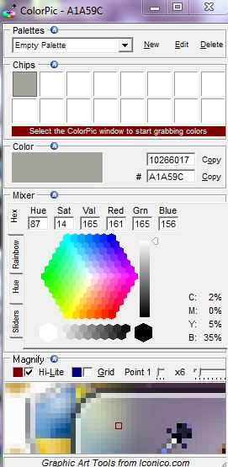
Check parameters of HSV Color Space
There are ranges of Hue values fixed for different colors .These values can be seen on http://mkweb.bcgsc.ca/color_summarizer/?faq
We would be needing a software colorpic to check
the hue saturation and value from images. It
can be downloaded from http://www.iconico.com/colorpic/
Colorpic

Slide 5
STEP1: Capture a frame from the camera
CvCapture* capture = cvCaptureFromCAM( 0 ); //0 is device id IplImage* frame = cvQueryFrame( capture ); //frame is captured
Device ID refers to ID of camera we would be using. If we are using device ID of camera of our Laptop, it is 0, and if we connect external cams, we need to check device ID. It is generally 1, in case of external cams.
cvQueryFrame() is used to capture a frame from camera of device id specified in the object capture.

Slide 6
STEP2: Convert the color model of image from RGB to HSV
The command used is:
cvCvtColor(frame, hsv_frame, CV_BGR2HSV);
It coverts the color model of the RGB image frame to HSV and stores it in HSV frame without affecting frame. The format of this command is:
cvCvtColor( imginit, imgfinal, color space conversion); where,
imginit=image whose color space is to be changed imgfinal=modified color space image color space conversion =CV_BGR2HSV //for rgb to hsv =CV_HSV2BGR//for hsv to rgb

Slide 7
STEP3: Specify the color to be detected by asigning the minimum and maximum values for hue saturation and value
CvScalar hsv_min = cvScalar(35, 80, 170, 0); //min value of h, s and v CvScalar hsv_max = cvScalar(55, 130, 255, 0); //max value of h, s and v This is in accordance with the color to be detected. It is also highly dependent on lighting conditions. The values of Hue Saturation and Value can be checked by using the software colorpic.
STEP4: Color detection
cvInRangeS(hsv_frame, hsv_min, hsv_max, thresholded);
This command checks for the regions in the image having the values of h, s and v within the permissible range, i.e. between hsv_min and hsv_max, and the binary image thus formed is stored in thresholded.

Slide 8
STEP5: Detection of circle
cvSmooth( thresholded, thresholded, CV_GAUSSIAN, 11, 11 ); //smoothing
of image
This command is used to smooth a image using Gaussian smoothing using a square of size 11x11. The area can range from 0x0 to 11x11, depending on whether the smoothing we require is used to detect small objects or not. The greater the area the better the detection of large objects. CvSeq* circles = cvHoughCircles(thresholded, storage, CV_HOUGH_GRADIENT, 2,thresholded->height/6, 100, 50, 10, 400); This command is used to detect circle shape in the binary image thresholded, and store the information regarding the radius and centre coordinates of circle in a sequence named “circles”. The format of the command is:
cvHoughCircles( IntPtr image,IntPtr circleStorage,HOUGH_TYPE method, double dp, double minDist, double param1,double param2,int minRadius, int maxRadius )

Slide 9
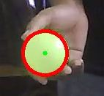
STEP6: Draw a circle of desired color around the detected circle
cvCircle( IntPtr img, Point center, int radius, MCvScalar color, int thickness, LINE_TYPE lineType, int shift) This command is used to draw a circle of radius r at centre coordinates x and y.
So, repeating the steps, we get a circle drawn of desired color over the circles present in the frame.

Slide 10
THANK YOU
Amit Arup Nayak Gigyanshu Ranjan Pradhan
nayakamitarup@gmail.com gigyanshupradhan@gmail.com

